Slide 1
CS 4504 Parallel and Distributed Computation Message Passing Interface (MPI)
Kun Suo
Computer Science, Kennesaw State University
https://kevinsuo.github.io/

Slide 2
Outline
MPI introduction
Helloworld of MPI
Performance evaluation
Example: how to solve problems in MPI
Trapezoidal problem

Slide 3
What is MPI?
Message Passing Interface (MPI) is a standardized library for parallel computing

Slide 4
A shared memory system

Slide 5
A distributed memory system

Slide 6
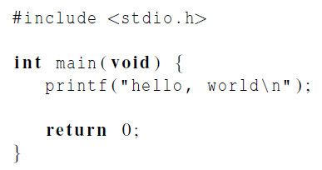
Hello World!

Slide 7
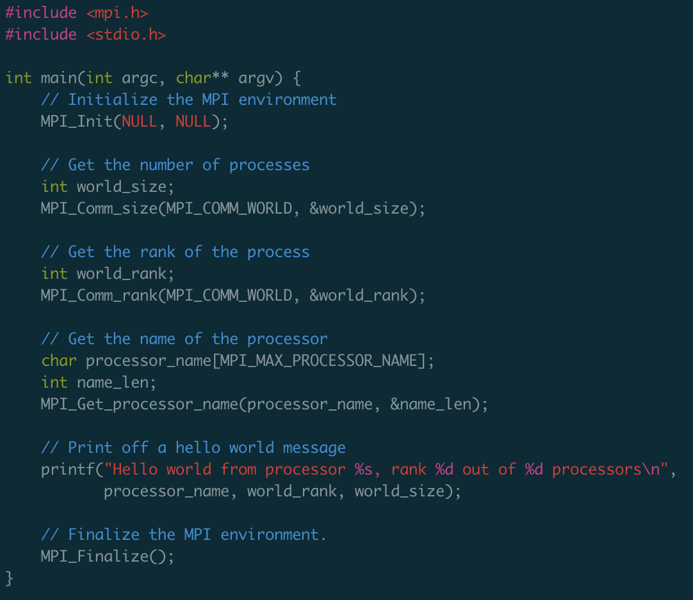
helloworld-mpi.c
https://github.com/kevinsuo/CS4504/blob/master/helloworld-mpi.c

Slide 8
MPI Programs
Written in C.
Has main.
Uses stdio.h, string.h, etc.
Need to add mpi.h header file.
Identifiers defined by MPI start with “MPI_”.
First letter following underscore is uppercase (e.g., MPI_Init).
For function names and MPI-defined types.
Helps to avoid confusion.

Slide 9
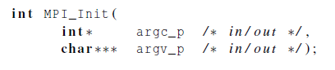
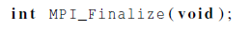
MPI Components
MPI_Init
Tells MPI to do all the necessary setup.
MPI_Finalize
Tells MPI we’re done, so clean up anything allocated for this program.

Slide 10
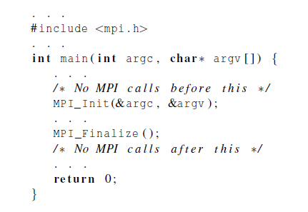
Basic Outline

Slide 11

MPI Components
MPI_Init
MPI_Finalize

Slide 12
helloworld-mpi.c
https://github.com/kevinsuo/CS4504/blob/main/helloworld-mpi.c

Slide 13

MPI Components
1) how many processes do I have?
2) how to differentiate them?
3) how they communicate?
MPI_Init
MPI_Finalize

Slide 14
Communicators
A collection of processes that can send messages to each other.
MPI_Init defines a communicator that consists of all the processes created when the program is started (defined by user).
Called MPI_COMM_WORLD. → Number of process

Slide 15
helloworld-mpi.c
https://github.com/kevinsuo/CS4504/blob/master/helloworld-mpi.c

Slide 16
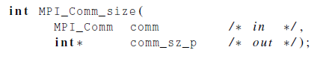
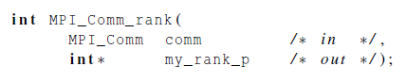
Communicators
number of processes in the communicator
my rank (the process making this call)

Slide 17
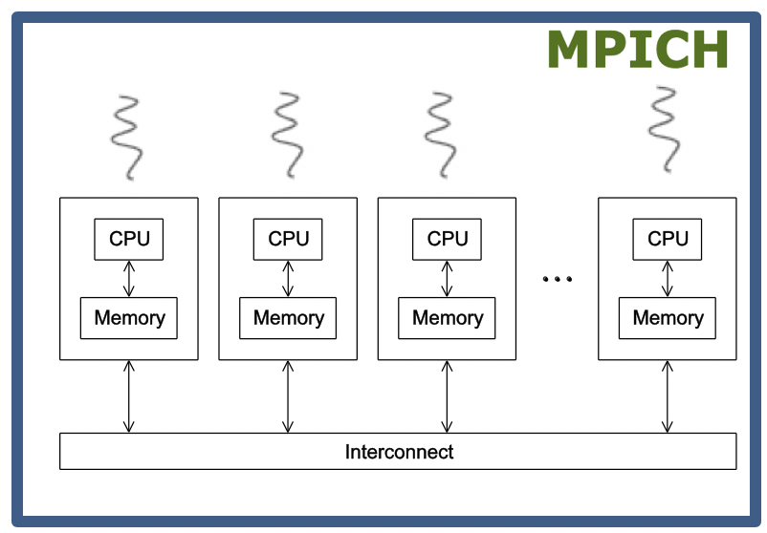
helloworld-mpi.c
https://github.com/kevinsuo/CS4504/blob/main/helloworld-mpi.c

Slide 18
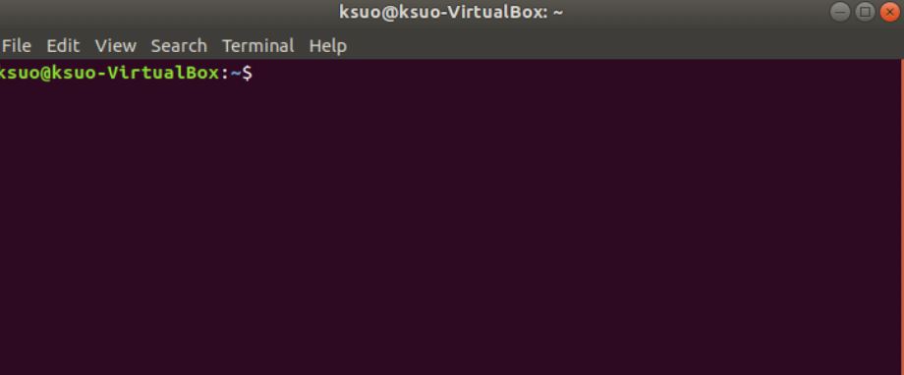
MPI_Get_processor_name(char *name,int *resultlen)
name: your machine name string
resultlen: your machine name string length
name: ksuo-VirtualBox
resultlen: 15

Slide 19
helloworld-mpi.c
https://github.com/kevinsuo/CS4504/blob/main/helloworld-mpi.c
...

Slide 20
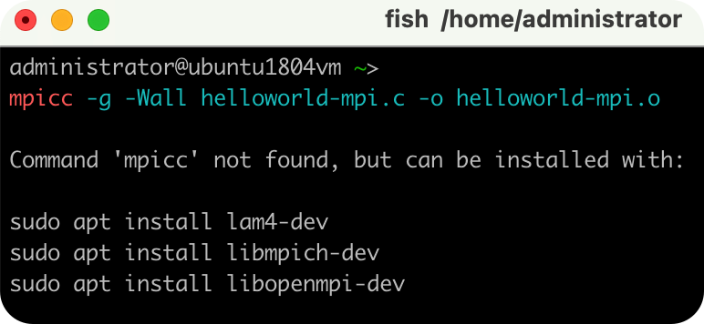
Compile
wrapper script to compile
source file
mpicc -g -Wall -o mpi_hello mpi_hello.c
produce debugging
information
create this executable file name
(as opposed to default a.out)
turns on all warnings

Slide 21
Execution
mpiexec -n <number of processes> <executable>
mpiexec -n 1 ./mpi_hello
run with 1 process
mpiexec -n 4 ./mpi_hello
run with 4 processes

Slide 22
Execution
mpiexec -n 1 ./mpi_hello
Greetings from process 0 of 1 !
mpiexec -n 4 ./mpi_hello
Greetings from process 0 of 4 !
Greetings from process 1 of 4 !
Greetings from process 2 of 4 !
Greetings from process 3 of 4 !

Slide 23
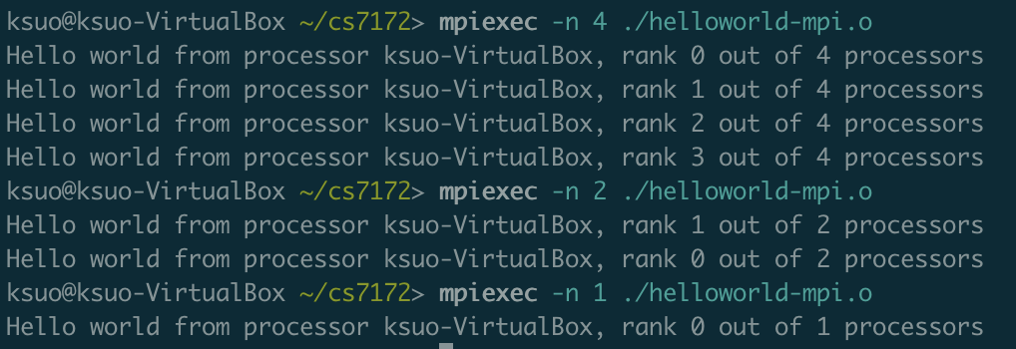
Execution
World_size: 4
World_rank: 2

Slide 24
helloworld-mpi.c
https://github.com/kevinsuo/CS4504/blob/main/helloworld-mpi.c

Slide 25
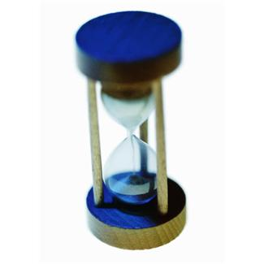
Performance evaluation

Slide 26
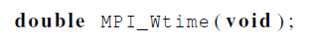
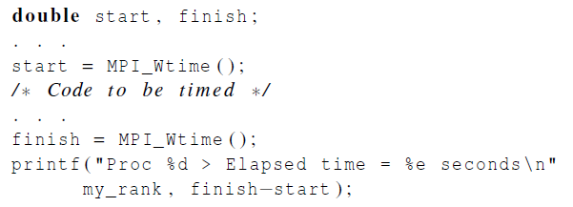
Elapsed parallel time
Returns the number of seconds that have elapsed since some time in the past.

Slide 27
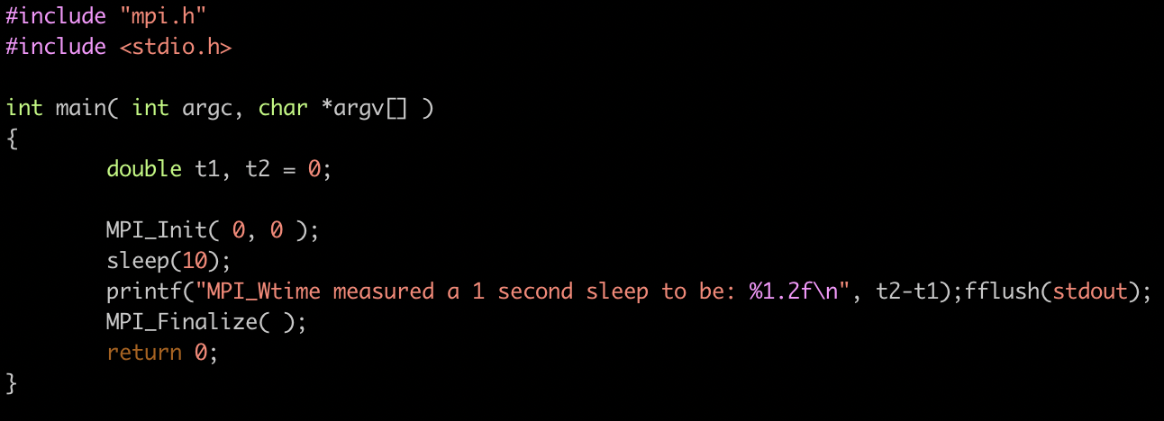
Example
https://raw.githubusercontent.com/kevinsuo/CS4504/master/time_sample.c

Slide 28
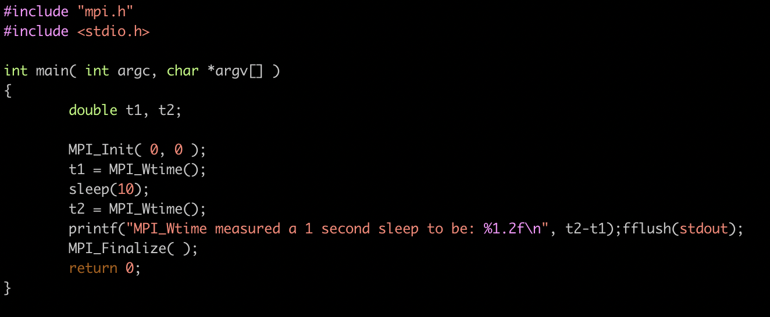
Example
https://raw.githubusercontent.com/kevinsuo/CS4504/master/time_sample.c

Slide 29
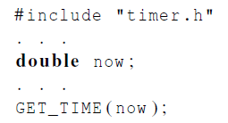

Elapsed serial time
In this case, you don’t need to link in the MPI libraries.
Returns time in microseconds elapsed from some point in the past.

Slide 30
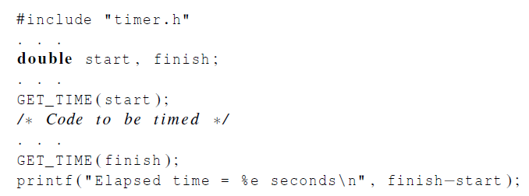
Elapsed serial time

Slide 31
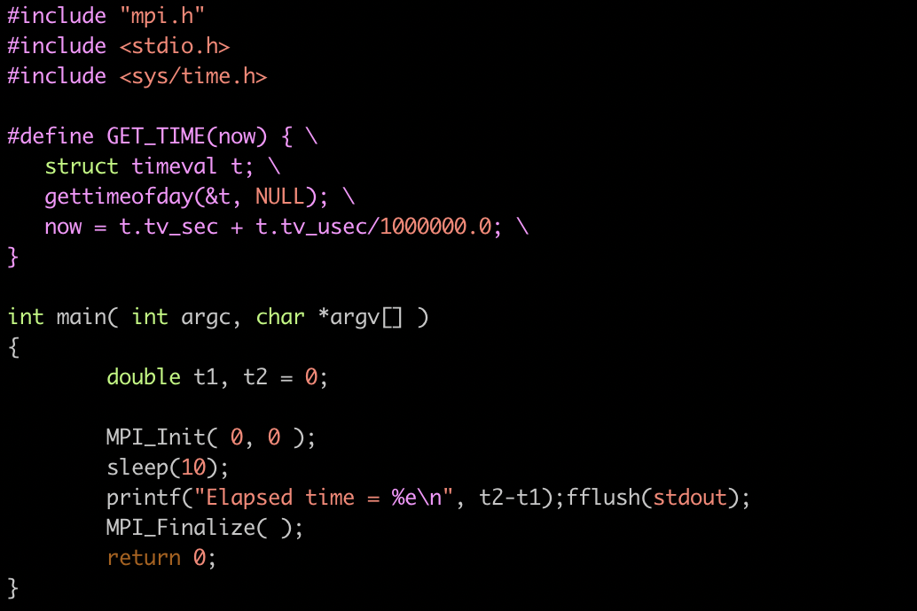
Example
https://raw.githubusercontent.com/kevinsuo/CS4504/master/time_sample2.c

Slide 32
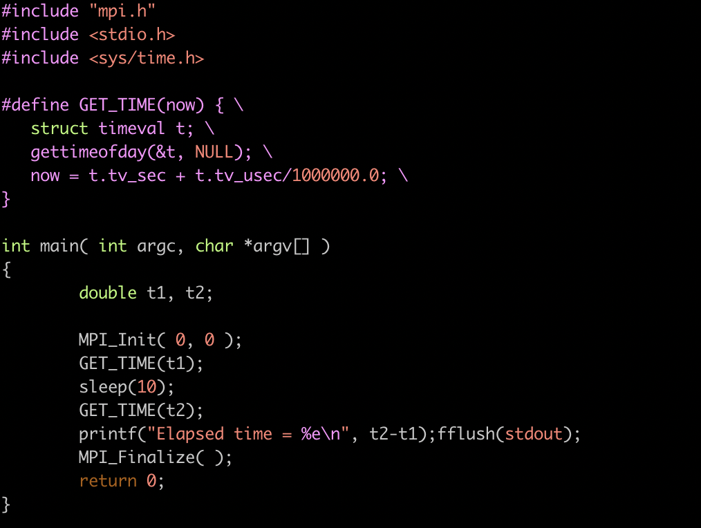
Example
https://raw.githubusercontent.com/kevinsuo/CS4504/master/time_sample2.c

Slide 33
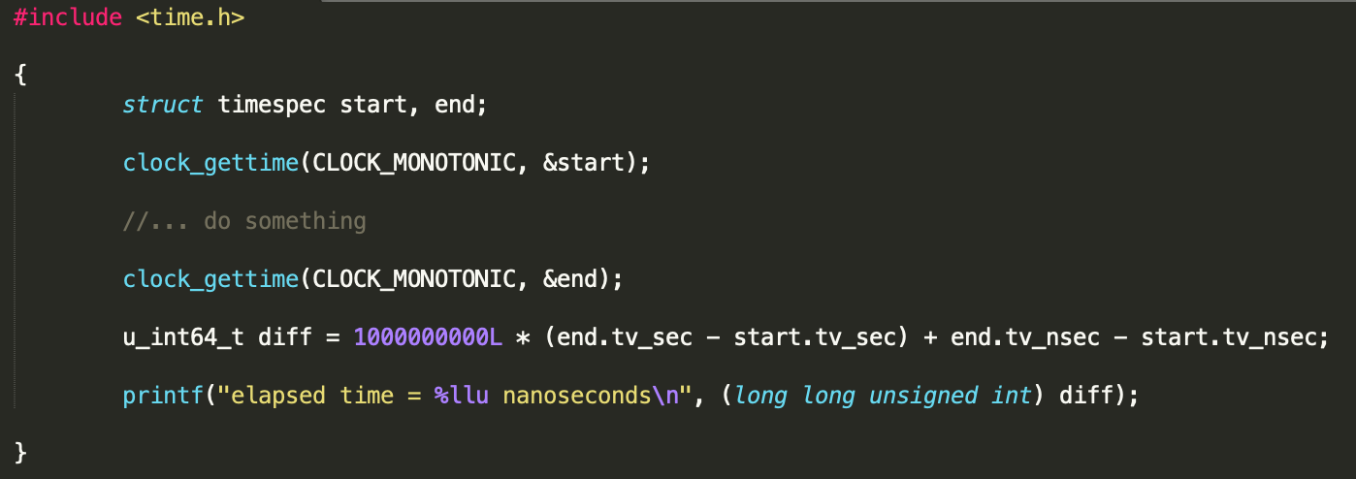
Elapsed serial time in nanoseconds

Slide 34
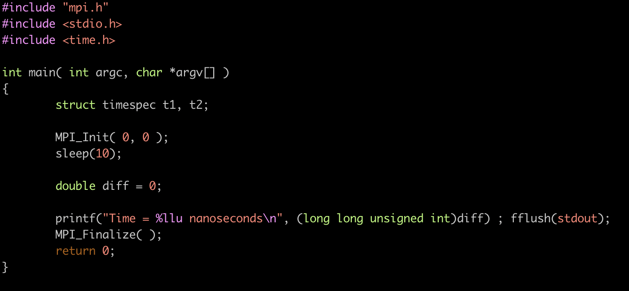
Example
https://github.com/kevinsuo/CS4504/blob/master/time_sample3.c

Slide 35
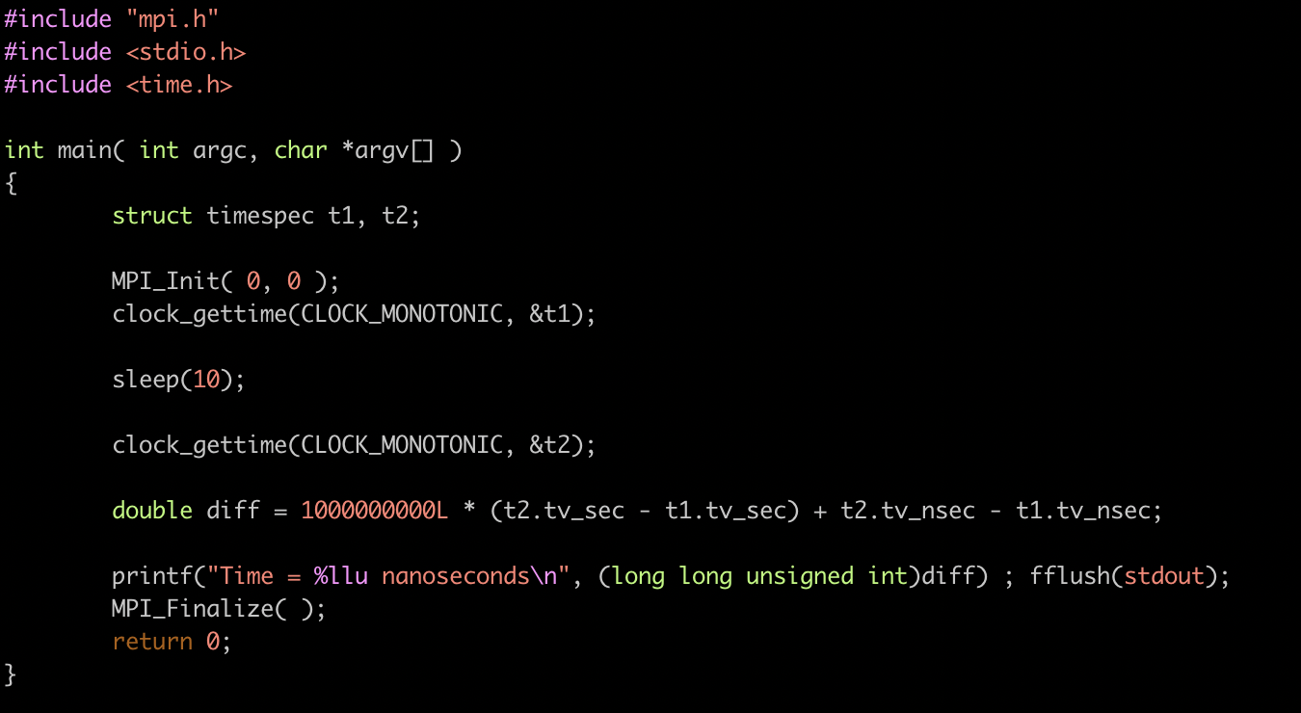
Example
https://github.com/kevinsuo/CS4504/blob/master/time_sample3.c

Slide 36
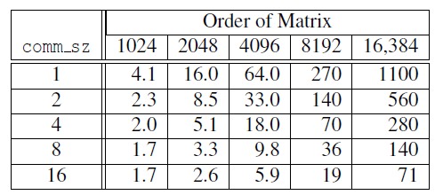
Run-times of serial and parallel matrix-vector multiplication
(Seconds)

Slide 37
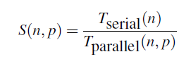
Speedup

Slide 38
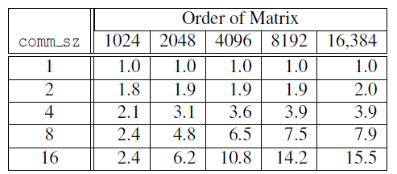
Speedups of Parallel Matrix-Vector Multiplication

Slide 39

Trapezoidal rule in mpi

Slide 40
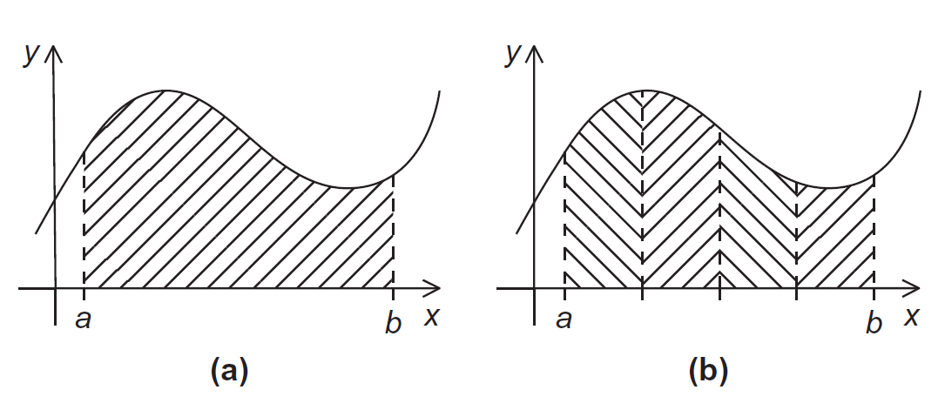
The Trapezoidal Rule

Slide 41
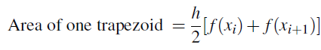
One trapezoid
How to get the size of one trapezoid?

Slide 42
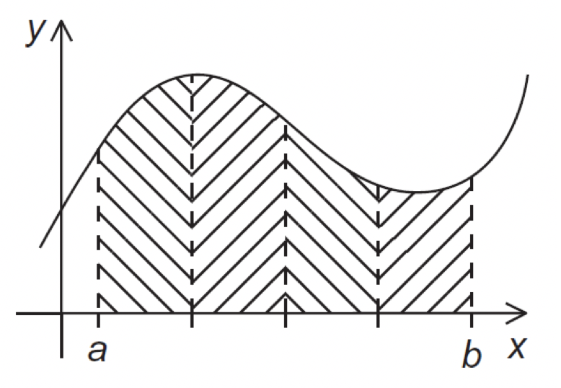
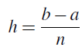

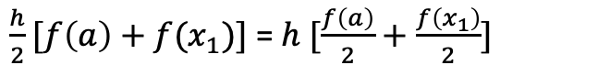
The Trapezoidal Rule
h
x₁
x₂
x_{n-1}
$\frac{h}{2}[f\left(a\right)+f(x_{1})]$ = $h [\frac{f\left(a\right)}{2}+\frac{f\left(x_{1}\right)}{2}]$

Slide 43
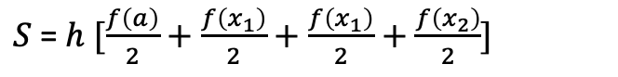

The Trapezoidal Rule
h
x₁
x₂
x_{n-1}
$S$= $h [\frac{f\left(a\right)}{2}+\frac{f\left(x_{1}\right)}{2}+\frac{f\left(x_{1}\right)}{2}+\frac{f\left(x_{2}\right)}{2}]$

Slide 44

The Trapezoidal Rule
h
x₁
x₂
x_{n-1}
$S$= $h [\frac{f\left(a\right)}{2}+\frac{f\left(x_{1}\right)}{2}+\frac{f\left(x_{1}\right)}{2}+\frac{f\left(x_{2}\right)}{2}+\frac{f\left(x_{2}\right)}{2}+\frac{f\left(x_{3}\right)}{2}]$

Slide 45



The Trapezoidal Rule
h
x₁
x₂
x_{n-1}

Slide 46
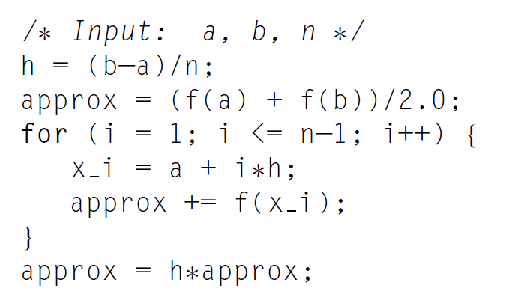






Pseudo-code for a serial program
(f(a) + f(b))/2
= (f(x₀) + f(x_{n}))/2

Slide 47
Parallelizing the Trapezoidal Rule
Partition problem solution into tasks.
Identify communication channels between threads.
Aggregate tasks into composite tasks.
Map composite tasks to threads/cores.

Slide 48
Parallelizing the Trapezoidal Rule
Partition problem solution into tasks.
What is the problem?
What is the task?

Slide 49
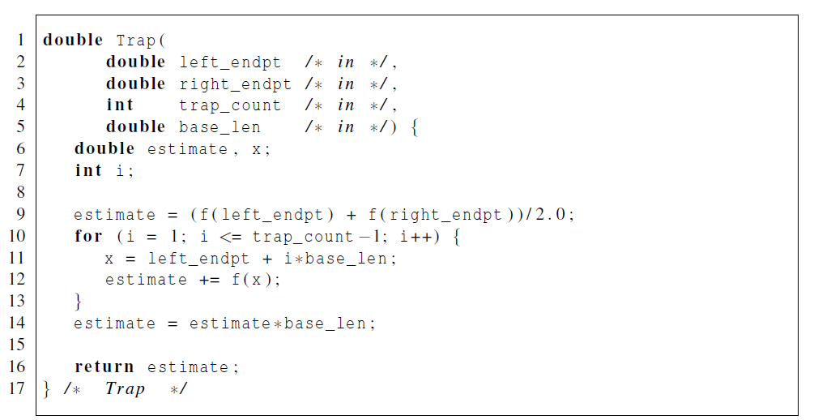
Parallelizing the Trapezoidal Rule
Partition problem solution into tasks.
// function logic
Left_endpt
Right_endpt
Base_len
Trap_count: how many tradezoid for each thread

Slide 50
Parallelizing the Trapezoidal Rule
Partition problem solution into tasks.
Identify communication channels between threads.

Slide 51




Tasks and communications for Trapezoidal Rule
I send
I send
Rank = 1
Rank = 2
Rank = n
I receive
Rank = 0

Slide 52
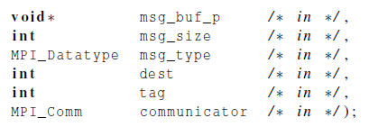

Communication
Send what?
How many?
Type?
To where?

Slide 53
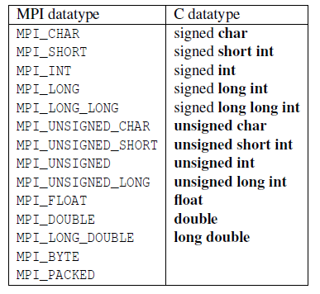
Data types

Slide 54
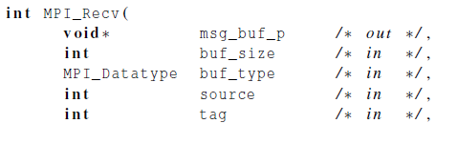
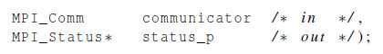
Communication
Recv what?
How many?
Type?
From where?

Slide 55

Message Sent From q to r
r
MPI_Send
src = q
MPI_Recv
dest = r
q

Slide 56
Parallelizing the Trapezoidal Rule
Partition problem solution into tasks.
Identify communication channels between threads.
Aggregate tasks into composite tasks.
Map composite tasks to threads/cores.

Slide 57
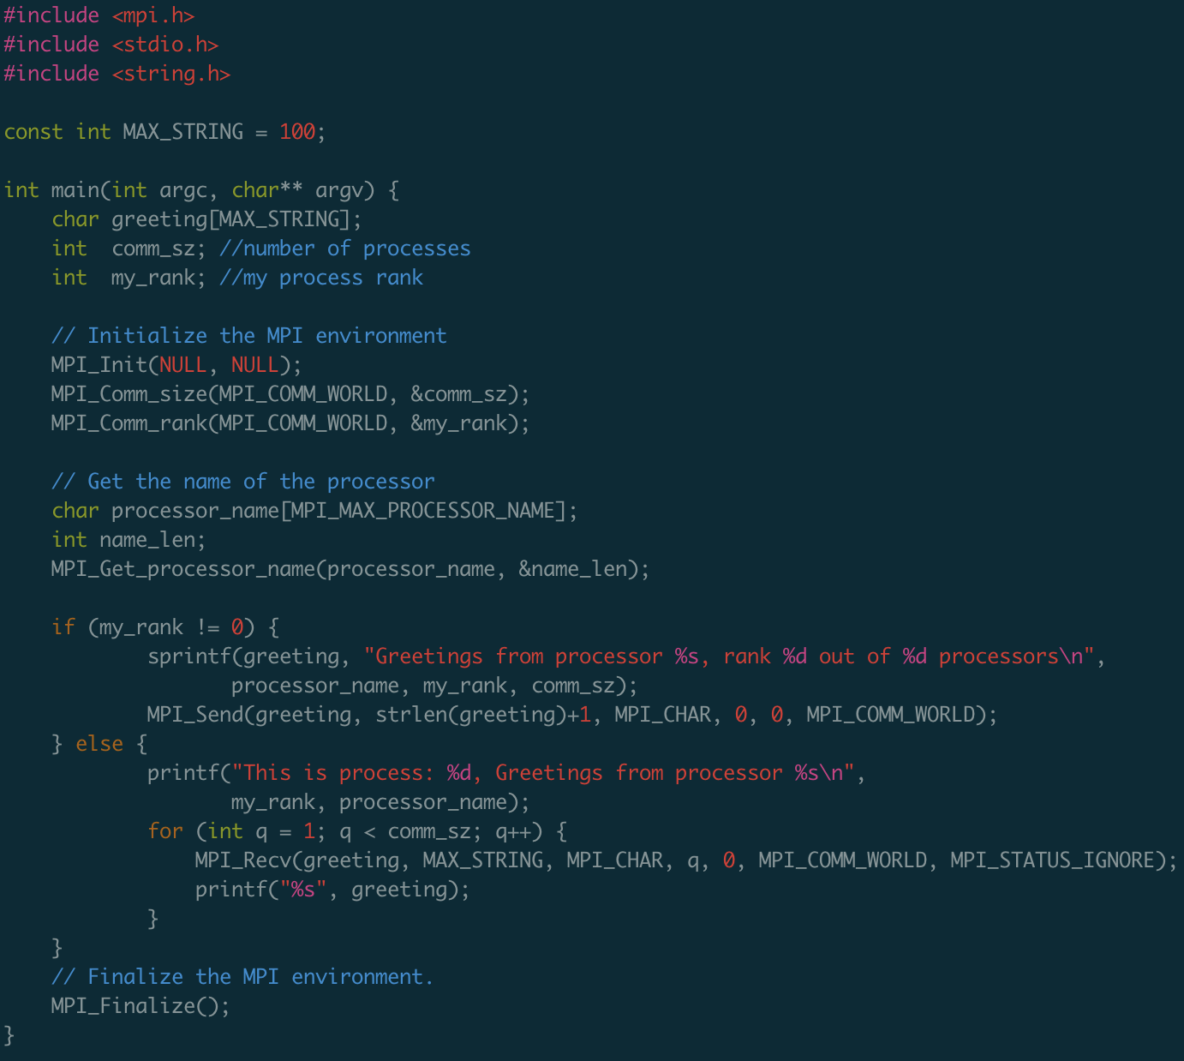

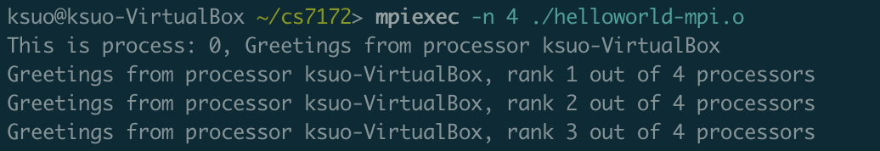
Example: 1/2/3 send to 0 and 0 prints out messages
1
0
2
3
Send to 0 from 1,…,comm_z-1

Slide 58
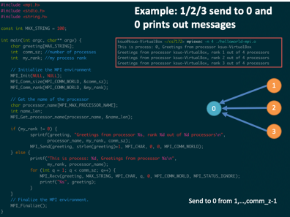

Sample code:
https://github.com/kevinsuo/CS4504/blob/master/helloworld-mpi-sample.c

Slide 59
Go back
I send
I send
Rank = 1
Rank = 2
Rank = n
I receive
Rank = 0

Slide 60
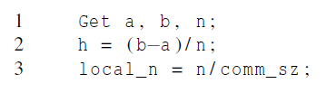
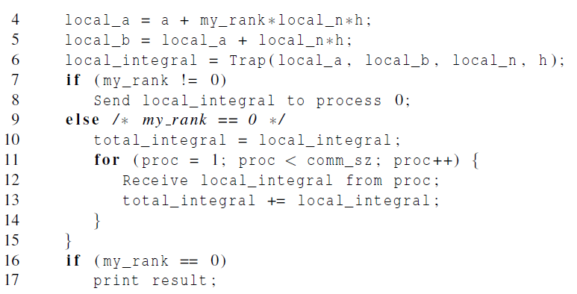
Parallel pseudo-code
Task

Slide 61
First version (1)

Slide 62
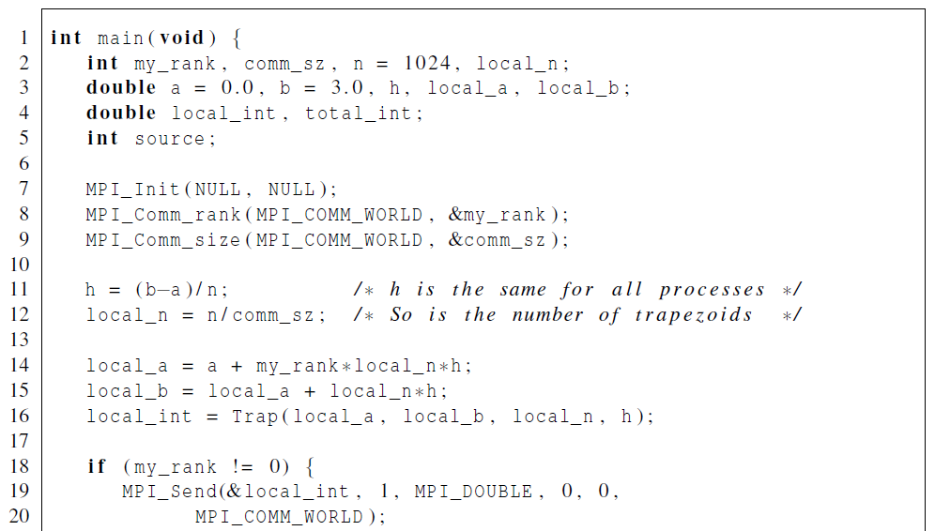

First version (2)
Please read the code by yourself based on the pseudo-code
local_a
local_b
local_n
h

Slide 63
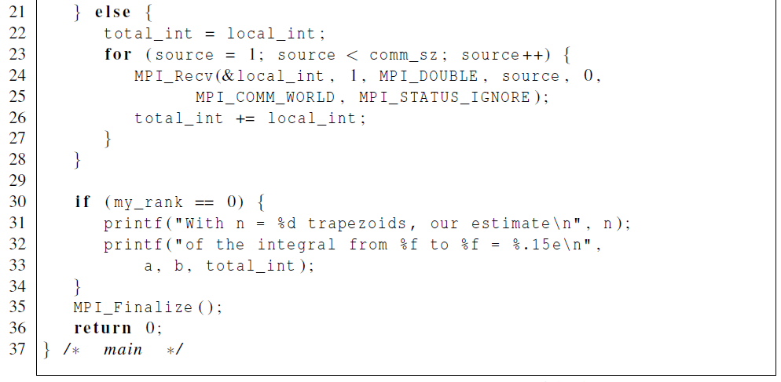
First version (3)

Slide 64
Conclusion
MPI introduction
Helloworld of MPI
Performance evaluation
Example: how to solve problems in MPI
Trapezoidal problem

Slide 65
Practice 1
https://github.com/kevinsuo/CS4504/blob/master/helloworld-mpi.c
Thread 0:
print out “000000”
Thread 1 & 2:
print out “121212”
Thread 3:
print out “333333”

Slide 66
Practice 2
https://github.com/kevinsuo/CS4504/blob/master/helloworld-mpi-sample.c
“000000”
0
1
“222222”
2
3

Slide 67
Practice 3
https://github.com/kevinsuo/CS4504/blob/master/helloworld-mpi-sample.c
“465”
0
1
“1+2+…+10”
2
“11+12+…+20”
3
“21+22+…+30”

